Slide 1
FoundationDB
Lecturer: Ngo Huy Bien
Software Engineering Department
Faculty of Information Technology
VNUHCM - University of Science
Ho Chi Minh City, Vietnam
nhbien@fit.hcmus.edu.vn

Slide 2

Objectives

Slide 3

Contents

Slide 4

References
Jingyu Zhou et al. (2021). FoundationDB: A Distributed Unbundled Transactional Key Value Store.

Slide 5
FoundationDB [1]
Providing serializable transactions while scaling to handle the large workloads.
Providing the foundational set of building blocks required to build higher-level distributed systems.
Providing a highly scalable, transactional storage engine with a minimal yet carefully chosen set of features.
Providing no structured semantics, no query language, data model or schema management, secondary indices or many other features one normally finds in a transactional database.

Slide 6
Database Simulation Framework
Before building the database itself, we built a deterministic database simulation framework that can simulate a network of interacting processes and a variety of disk, process, network, and request-level failures and recoveries, all within a single physical process.

Slide 7
Unbundled Architecture
FDB adopts an unbundled architecture that comprises a control plane and a data plane.
The control plane manages the metadata of the cluster and uses Active Disk Paxos for high availability.
The data plane consists of a transaction management system, responsible for processing updates, and a distributed storage layer serving reads; both can be independently scaled out.
FDB achieves strict serializability through a combination of optimistic concurrency control (OCC) and multi-version concurrency control (MVCC).

Slide 8
System Interface
The get() and set() operations read and write a single key-value pair, respectively.
For ranges, 𝑔𝑒𝑡𝑅𝑎𝑛𝑔𝑒() returns a sorted list of keys and their values within the given range; and 𝑐𝑙𝑒𝑎𝑟() deletes all keys-value pairs whithin a range or starting with a certain key prefix.
A transaction’s writes (i.e., set() and clear() calls) are buffered by the FDB client until the final commit() call, and read-your-write semantics are preserved by combining results from database look-ups with uncommitted writes of the transaction.
Key and value sizes are limited to 10 KB and 100 KB respectively for better performance. Transaction size is limited to 10 MB.

Slide 9
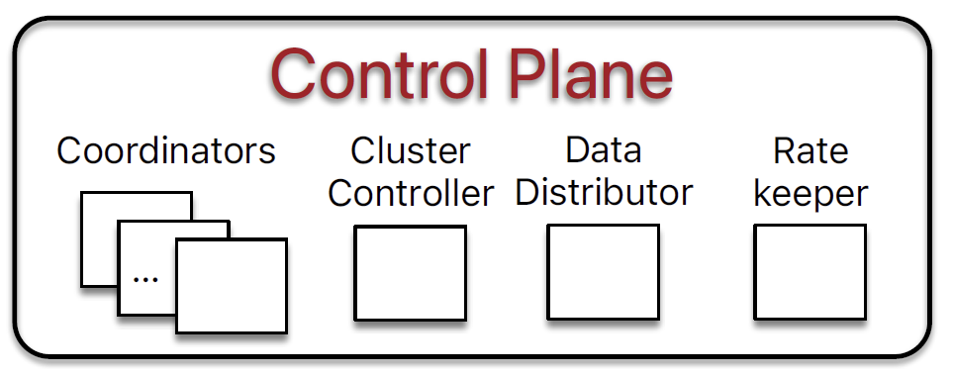
Architecture: Control Plane
The control plane is responsible for persisting critical system metadata, i.e., the configuration of transaction systems, on Coordinators.
The ClusterController monitors all servers in the cluster and recruits three singleton processes, Sequencer, DataDistributor, and Ratekeeper, which are re-recruited if they fail or crash.
The Sequencer assigns read and commit versions to transactions.
The DataDistributor is responsible for monitoring failures and balancing data among StorageServers.
Ratekeeper provides overload protection for the cluster.

Slide 10
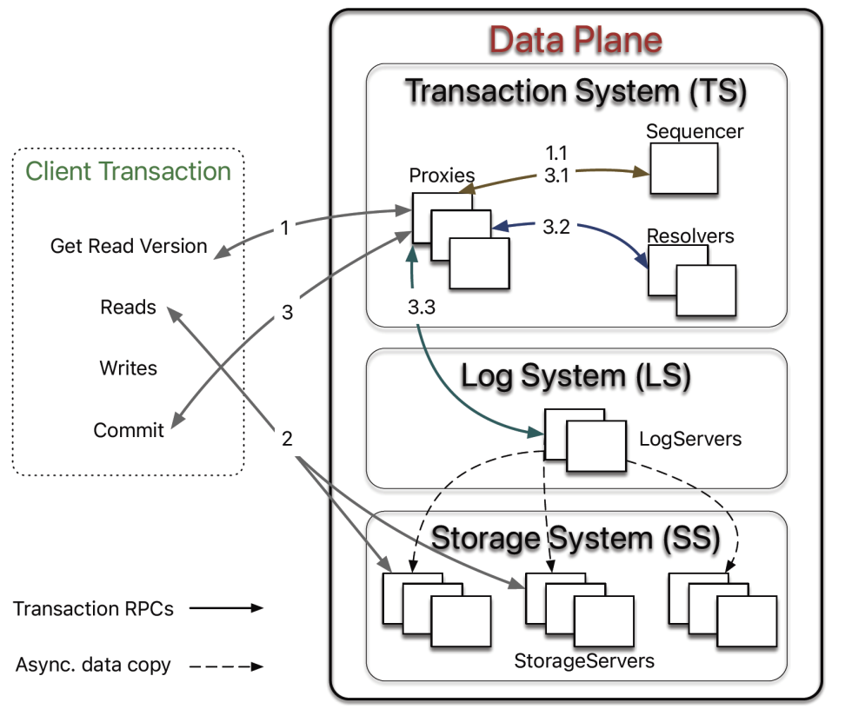
Architecture: Data Plane
FDB chooses an unbundled architecture:
a distributed transaction management system (TS) performs in-memory transaction processing,
a log system (LS) stores Write-Ahead-Log (WAL) for TS, and
a separate distributed storage system (SS) is used for storing data and servicing reads.

Slide 11


Slide 12
FoundationDB Packages
https://github.com/apple/foundationdb/releases
For Linux distributions, there are two packages: fdbserver and fdbcli.
The first is for running the FoundationDB server itself, and the second is for connecting to the database.

Slide 13
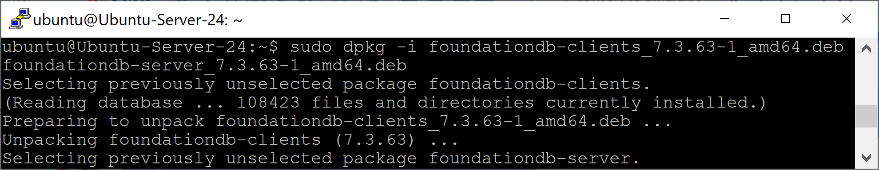
1. Install FoundationDB on Ubuntu
Check versions on https://github.com/apple/foundationdb/releases
wget https://github.com/apple/foundationdb/releases/download/7.3.63/foundationdb-clients_7.3.63-1_amd64.deb
wget https://github.com/apple/foundationdb/releases/download/7.3.63/foundationdb-server_7.3.63-1_amd64.deb
sudo dpkg -i foundationdb-clients_7.3.63-1_amd64.deb foundationdb-server_7.3.63-1_amd64.deb

Slide 14
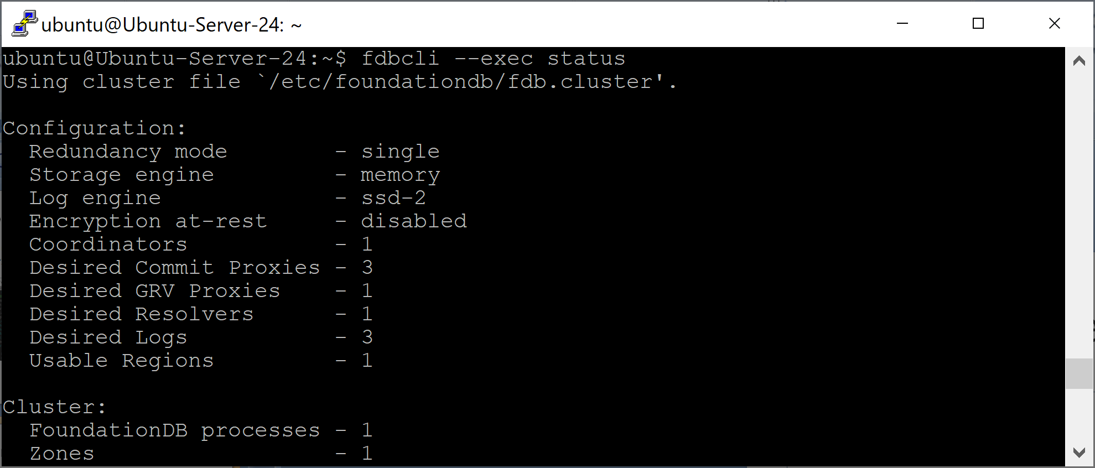
2. Verify the Install
fdbcli --exec status

Slide 15
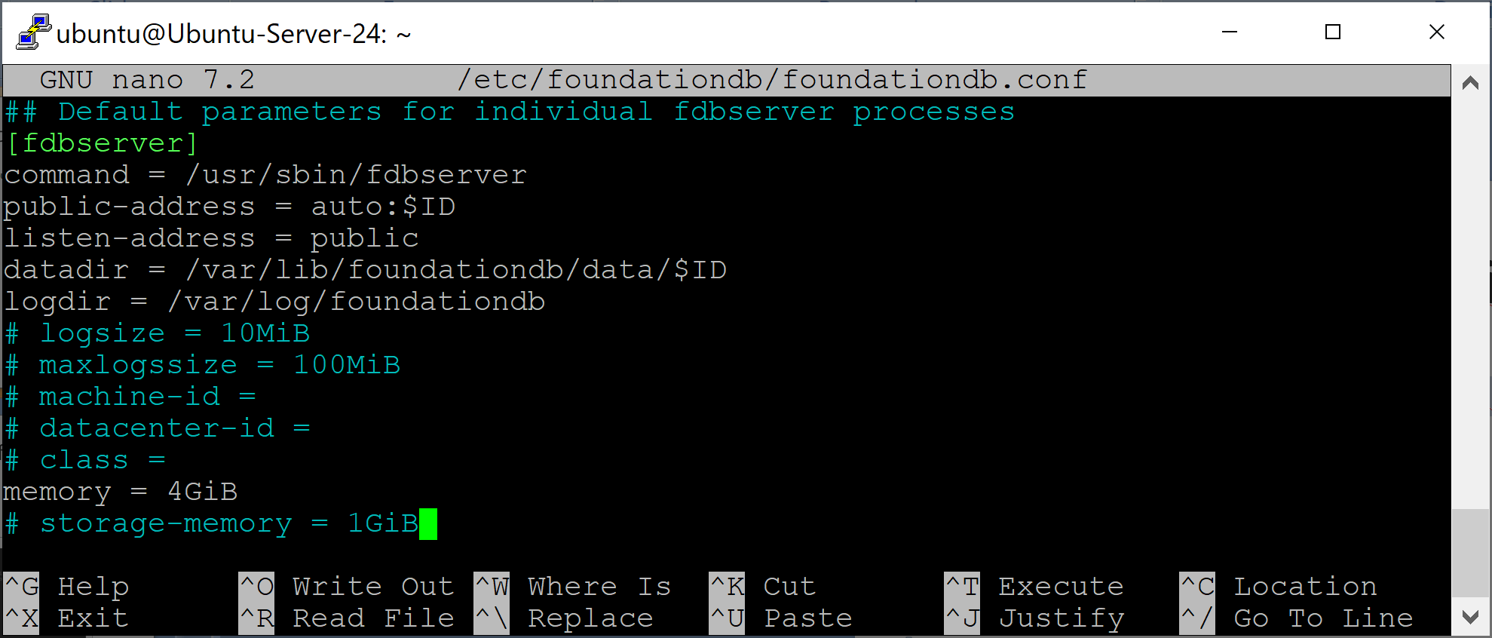
3. Configure FoundationDB
sudo nano /etc/foundationdb/foundationdb.conf
memory = 4GiB
sudo ls /var/lib/foundationdb/data

Slide 16
4. Install foundationdb for python3
python3 --version
sudo apt install python3-pip
pip --version
sudo apt install python3-venv
mkdir fdb
cd fdb
python3 -m venv .venv
source .venv/bin/activate
pip install foundationdb
python

Slide 17
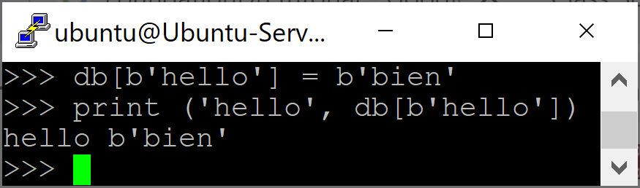
5. Call FoundationDB APIs
import fdb
fdb.api_version(730)
db = fdb.open()
db[b'hello'] = b'world'
print ('hello', db[b'hello'])
db[b'hello'] = b'bien'
print ('hello', db[b'hello'])

Slide 19
Data Model
https://apple.github.io/foundationdb/developer-guide.html
FoundationDB’s core data model is an ordered key-value store.
Both keys and values in FoundationDB are simple byte strings.
Apart from storage and retrieval, the database does not interpret or depend on the content of values.

Slide 20
Namespaces
The keys in FoundationDB’s key-value store can be viewed as elements of a single, global keyspace.
Your application will probably have multiple kinds of data to store, and it’s a good idea to separate them into different namespaces.
The use of distinct namespaces will allow you to avoid conflicts among keys as your application grows.
Because of the ordering of keys, a namespace in FoundationDB is defined by any prefix prepended to keys. For example, if we use a prefix 'alpha', any key of the form 'alpha' + remainder will be nested under 'alpha'.

Slide 21
Subspaces & Directories
Subspaces employ the tuple layer to provide a convenient syntax for namespaces.
While subspaces can be used directly, they are also returned when creating or opening a directory. Directories are designed to manage related subspaces.
FoundationDB provides directories (available in each language binding) as a tool for managing related subspaces.
Directories are a recommended approach for administering applications. Each application should create or open at least one directory to manage its subspaces.

Slide 22
1. Creating Directories and Data
a = fdb.directory.create(db, ('alpha',))
b = a.create(db, ('bravo',))
c = b.create(db, ('charlie',))
a.get_path()
b.get_path()
users = fdb.directory.create(db, ('users',))
stores = fdb.directory.list(db)
print(stores)
db[users['X']] = b'10'
db[users['Y']] = b'200'
print (db[users[b'X']])
print (db[users[b'Y']])

Slide 23
2. Open Directory
users = fdb.directory.open(db, ('users',))
users
# Out: DirectorySubspace(path=('users',), prefix=b'\x15$')
db[users['X']] = b'3'
print(db[users['X']])

Slide 24
3. Delete Directory
stores = fdb.directory.list(db)
print(stores)
fdb.directory.remove_if_exists(db, ('bankaccounts'))
print(stores)

Slide 26
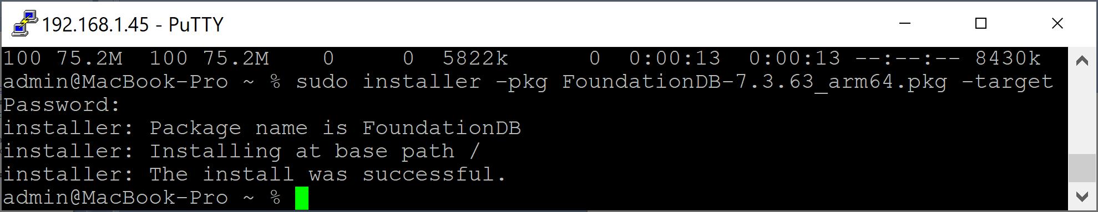
1. Install FoundationDB on macOS
Check versions on https://github.com/apple/foundationdb/releases
curl -L -o FoundationDB-7.3.63_arm64.pkg https://github.com/apple/foundationdb/releases/download/7.3.63/FoundationDB-7.3.63_arm64.pkg
sudo installer -pkg FoundationDB-7.3.63_arm64.pkg -target /

Slide 27
2. Manage FoundationDB
https://apple.github.io/foundationdb/getting-started-mac.html
ls /usr/local/etc/foundationdb/
cat /usr/local/etc/foundationdb/fdb.cluster
sudo launchctl unload /Library/LaunchDaemons/com.foundationdb.fdbmonitor.plist
sudo launchctl load /Library/LaunchDaemons/com.foundationdb.fdbmonitor.plist
fdbcli --exec status

Slide 29
Terms
https://medium.com/@yuriymomotenko/setting-up-a-scalable-foundationdb-cluster-a-step-by-step-guide-6f84f4182c63
FoundationDB operates by running processes with different roles: storage, transaction, and stateless.
A single process can have multiple roles.
A cluster is a multiple physical server running FoundationDB processes for one big database.
When building a cluster, the amount of total transactions and stateless processes are counted among all of the servers in the cluster.

Slide 30
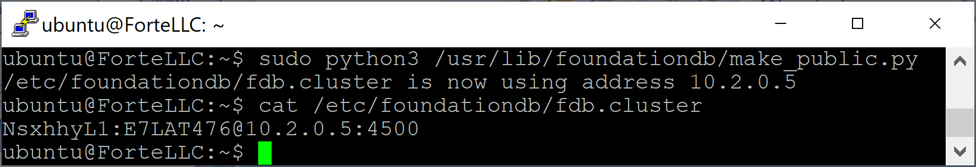
1. Expose Database on Machine 1
https://apple.github.io/foundationdb/building-cluster.html
sudo python3 /usr/lib/foundationdb/make_public.py
By default, the script will pick a local network interface that can access the internet.
To specify the address manually, use the -a flag and choose an address that is accessible by all machines in the cluster as well as by all intended clients.
sudo python3 /usr/lib/foundationdb/make_public.py -a 10.0.1.1
cat /etc/foundationdb/fdb.cluster
sudo reboot
FDB is overall not good with NAT rewriting IPs.

Slide 31
2. Install FoundationDB on Machine 2
Check versions on https://github.com/apple/foundationdb/releases
wget https://github.com/apple/foundationdb/releases/download/7.3.63/foundationdb-clients_7.3.63-1_amd64.deb
wget https://github.com/apple/foundationdb/releases/download/7.3.63/foundationdb-server_7.3.63-1_amd64.deb
sudo dpkg -i foundationdb-clients_7.3.63-1_amd64.deb foundationdb-server_7.3.63-1_amd64.deb
fdbcli --exec status
sudo reboot

Slide 32
4. Replicate fdb.cluster
On Ubuntu 1:
cat /etc/foundationdb/fdb.cluster
On Windows (under Admin):
scp -i C:/Users/admin/Downloads/private_key.pem ubuntu@13.88.45.59:/etc/foundationdb/fdb.cluster C:/Users/admin/Downloads
scp -i C:/Users/admin/Downloads/private_key.pem C:/Users/admin/Downloads/fdb.cluster ubuntu@40.83.166.123:/home/ubuntu
On Ubuntu 2:
sudo cp fdb.cluster /etc/foundationdb/
rm fdb.cluster

Slide 33
5. Replicate foundationdb.conf
On Ubuntu 1:
cat /etc/foundationdb/foundationdb.conf
On Windows:
scp -i C:/Users/admin/Downloads/private_key.pem ubuntu@13.88.45.59:/etc/foundationdb/foundationdb.conf C:/Users/admin/Downloads
scp -i C:/Users/admin/Downloads/private_key.pem C:/Users/admin/Downloads/foundationdb.conf ubuntu@40.83.166.123:/home/ubuntu
On Ubuntu 2:
sudo cp foundationdb.conf /etc/foundationdb/
sudo service foundationdb restart
rm foundationdb.conf
sudo reboot

Slide 34
6. Open 4500 Port
fdbcli --exec status
sudo ufw status
sudo ufw disable
sudo service foundationdb status
sudo systemctl enable foundationdb

Slide 35
6. Change redundancy mode
https://apple.github.io/foundationdb/configuration.html#configuration-choosing-redundancy-mode
single mode(best for 1-2 machines)
FoundationDB does not replicate data and needs only one physical machine to make progress. Because data is not replicated, the database is not fault-tolerant. This mode is recommended for testing on a single development machine. (single mode will work with clusters of two or more computers and will partition data for increased performance but the cluster will not tolerate the loss of any machines.)

Slide 36
7. Change storage engine
https://apple.github.io/foundationdb/configuration.html#configuration-storage-engine
A storage engine is the part of the database that is responsible for storing data to disk.
FoundationDB has two storage engines options, ssd and memory.
fdbcli
configure storage_migration_type=aggressive
configure ssd
fdbcli --exec status

Slide 37
8. Install foundationdb for python3
sudo apt install python3.12-venv
mkdir fdb
cd fdb
python3 -m venv .venv
source .venv/bin/activate
pip install foundationdb
python

Slide 38
9. Call Remote FoundationDB APIs
import fdb
fdb.api_version(730)
db = fdb.open()
print(db[users['X']])

Slide 40
1. Remove FoundationDB
apt-cache search 'foundationdb'
sudo apt remove foundationdb-clients

Slide 41
2. Configure Firewall
sudo ufw status
sudo ufw enable
sudo ufw allow 22/tcp
sudo ufw allow 4500/tcp

Slide 42

Thank You & See You Again

